Slide 1
Nanometre Wide Avalanche Regions for High Performance SPADs: A review
Project members:
Salman Abdullah, ESR, EEE, Sheffield Prof. Chee Hing Tan, EEE, Sheffield Dr. Jo Shien Ng, EEE, Sheffield
PROMIS workshop Cadiz, 18th -20th May, 2016, Cadiz, Spain

Slide 2
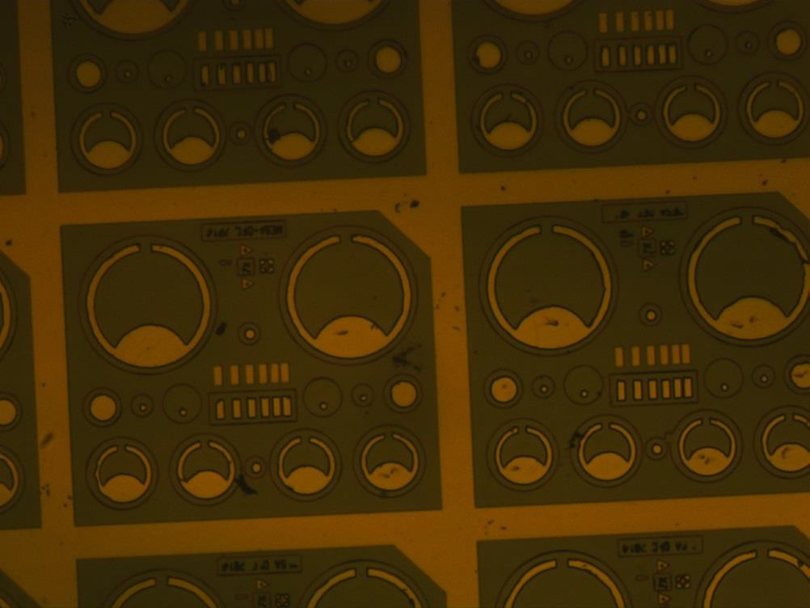
Device structure and field profile
E-field
Top contact
Top N-layer
Multiplication Charge sheet Grading Absorption Grading Bottom-P layer
Semi Insultaing-Substrate

Slide 3
C-V measurement for APDs with high leakage
SF1082, NIPIP, R=110um
7.4e-12
-10
CV measurement for an InGaAs/AlGaAsSb SAMAPD
7.2e-12
110um_1
110um_2
-20
7.0e-12
Phase angle [Degrees]
-30
Capacitance [F]
6.8e-12
-40
Higher leakage (Dark currents) do not permit accurate C measurement
6.6e-12
-50
6.4e-12
6.2e-12
-60
6.0e-12
-70
5.8e-12
-80
5.6e-12
-90
0
5 10 15
Reverse bias [V]
20
25
0
5 10 15
Reverse bias [V]
20
25

Slide 4
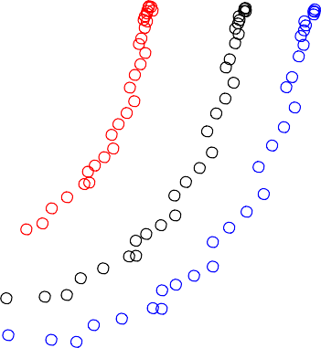
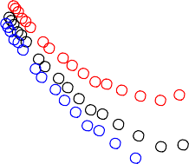
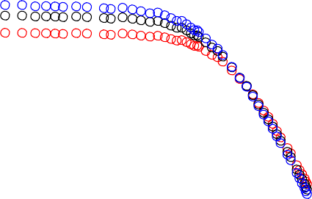
Z-F (three element model)technique for leaky
devices
SF1082, R=110um, NIPIP
SF1082, R=110um NIPIP
0
Exp. data 18.7V Exp. data 17.2V Exp. data 16.5V
Z-F fit, R_{p}=10536
Z-F fit, R_{p}=12821
Z-F fit, R_{p}=14487
10⁵
-2000
Imag (Z)
-4000
Real (Z)
10⁴
-6000
Exp.data, 18.7 V
Exp.data, 17.2 V
Exp.data, 16.5 V Z-F fit, C=8.6 pF Z-F fit, C=8.39 pF Z-F fit, C=8.52 pF
-8000
-10000
10³
0 2000 4000 6000
8000 10000 12000 14000 16000 18000
Real (Z)
10⁴
10⁵
10⁶
Test signal freq. [Hz]
10⁷
10⁸
E. Andres et al., IEEE Trans. Elec. Device,
54(7), 2007

Slide 5
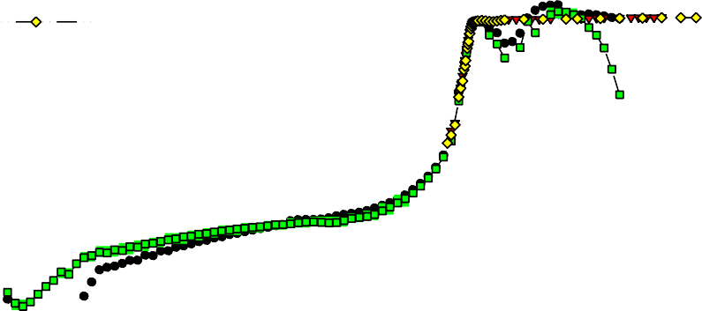
Competing effects of PEB and avalanche
multiplication
SF1082, R=110um
₁₀-2
10⁶
10⁵
10⁴
10³
₁₀-3
Id_110a Itotal_110a Id_110b Itotal_110b DC_Resp_110a AC_resp_110a DC_resp_110b AC_resp_110b
₁₀-4
Responsivity (DC+AC) [A/W]
Current (Dark+Total) [A]
10
2
₁₀-5
10¹
10⁰
₁₀-1
₁₀-2
₁₀-3
₁₀-4
₁₀-5
₁₀-6
₁₀-7
₁₀-6
₁₀-7
₁₀-8
₁₀-9
₁₀-10
₁₀-11
0
2
4
6
8 10 12
Reverse bias [V]
14
16
18
20

Slide 6
Future plans
Device fabrication
Surface treatment to avoid oxidation of AlGaAsSb layer
Improve etching recipe e.g. to remove Al2O3
Characterization and assessment of devices

Slide 7
Thank you for your attention!!

